Slide 1
Internetworking -4 (Chapter 3)

Slide 2
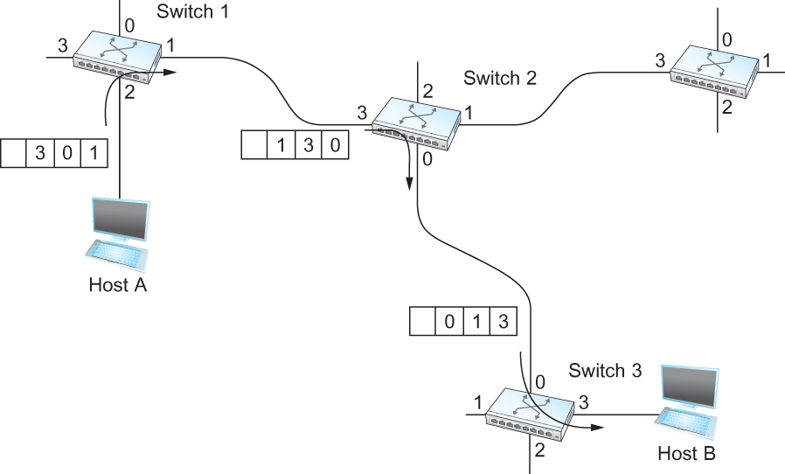
Source Routing
All the information about network topology that is required to switch a packet across the network is provided by the source host

Slide 3
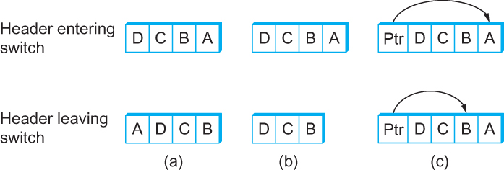
Source Routing-2
Other approaches in Source Routing

Slide 4
Bridges and LAN Switches
Bridges/ LAN Switches
Used to forward packets between shared-media LANs such as Ethernets
Suppose you have a pair of Ethernets that you want to interconnect
One approach is put a repeater in between them
It might exceed the physical limitation of the Ethernet
No more than four repeaters between any pair of hosts
No more than a total of 2500 m in length is allowed
An alternative: Bridges/LAN Switches
Extended LAN

Slide 5
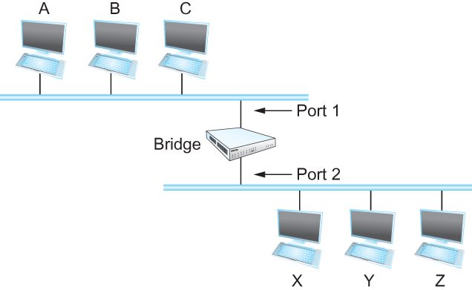
Switches
Simplest Strategy for Switches
Accept LAN frames on their inputs and forward them out to all other outputs
Self-Learning Switches
Observe that there is no need to forward all the frames that a bridge receives
Host Port
--------------------
A 1
B 1
C 1
X 2
Y 2
Z 2

Slide 6
Ethernet switch
link-layer device: takes an active role
store, forward Ethernet frames
examine incoming frame’s MAC address, selectively forward frame to one-or-more outgoing links when frame is to be forwarded on segment, uses CSMA/CD to access segment
transparent
hosts are unaware of presence of switches
plug-and-play, self-learning
switches do not need to be configured

Slide 7



Switch: multiple simultaneous transmissions
hosts have dedicated, direct connection to switch
switches buffer packets
Ethernet protocol used on each incoming link, but no collisions; full duplex
each link is its own collision domain
switching: A-to-A’ and B-to-B’ can transmit simultaneously, without collisions
A
C’
B
6
1
2
5
4
3
B’
C
A’
switch with six interfaces
(1,2,3,4,5,6)

Slide 8
Switch forwarding table
Q: how does switch know A’ reachable via interface 4, B’ reachable via interface 5?
A
C’
B
A: each switch has a switch table, each entry:
(MAC address of host, interface to reach host, time stamp)
looks like a routing table!
6
1
2
5
4
3
B’
C
A’
Q: how are entries created, maintained in switch table?
something like a routing protocol?
switch with six interfaces
(1,2,3,4,5,6)

Slide 9
Switch: self-learning
Source: A
Dest: A’
switch learns which hosts can be reached through which interfaces
when frame received, switch “learns” location of sender: incoming LAN segment
records sender/location pair in switch table
A
A A’
C’
B
6
1
2
5
4
3
B’
C
A’
MAC addr interface TTL
A
1
60
Switch table
(initially empty)

Slide 10
Switch: frame filtering/forwarding
when frame received at switch:
1. record incoming link, MAC address of sending host
2. index switch table using MAC destination address
3. if entry found for destination then {
if destination on segment from which frame arrived then drop frame
else forward frame on interface indicated by entry
}
else flood /* forward on all interfaces except arriving
interface */

Slide 11
Self-learning, forwarding: example
Source: A
Dest: A’
A
A A’
frame destination, A’, locaton unknown:
flood
C’
B
destination A location known:
6
1
2
A A’
A A’
A A’
A A’
selectively send
on just one link
A A’
5
4
3
B’
C
A’ A
A’
MAC addr interface TTL
A
1
60
switch table
(initially empty)
A’
4
60

Slide 12

Interconnecting switches
switches can be connected together
S₄
S₁
S₃
A
S₂
F
I
B
C
D
E
G
H
Q: sending from A to G - how does S₁ know to forward frame destined to F via S₄ and S₃?
A: self learning! (works exactly the same as in single-switch case!)

Slide 13
Self-learning multi-switch example
Suppose C sends frame to I, I responds to C
S₄
S₁
S₃
A
S₂
F
I
B
C
D
E
G
H
Q: show switch tables and packet forwarding in S₁, S₂, S₃, S₄

Slide 14
Institutional network
mail server
to external
network
router
web server
IP subnet

Slide 15
Switches vs. routers
application
transport
network
link
physical
both are store-and-forward:
routers: network-layer devices (examine network-layer headers)
switches: link-layer devices (examine link-layer headers)
both have forwarding tables:
routers: compute tables using routing algorithms, IP addresses
switches: learn forwarding table using flooding, learning, MAC addresses
datagram
frame
link
physical
frame
switch
network
link
physical
datagram
frame
application
transport
network
link
physical

